Slide 1
Data-Types, Primitives & Variables
JavaScript

Slide 2
What are Data-Types?
Most any programming language has a set of “Data-Types.” This is the type of data that can be inputted, stored, used, outputted, or handled by programs written in that language.
For example, you might want to store some text for a user’s name. Or a floating-point (decimal) number for the price of a product!
Different types of data can often be used in specific ways. Think about it… if you have a name, you might want to put that in a sentence: “Hello, Bob!” If you have a number, you might want to add that to another number: 5.05 + 2.50 = 7.55.
You typically wouldn’t want to apply mathematical addition to some text. Programming languages often enforce rules to ensure we are dealing with data correctly. JavaScript isn’t particularly strict on this, so as developers we have to be careful with our data to ensure our operations don’t lead to unexpected results.

Slide 3
Data-Types in JavaScript
Primitives are data-types that are not considered “objects” in the traditional sense (you do not need to use the “new” keyword to instantiate them) and can be distinguished using the “typeof” operator.
Primitives in JavaScript include:
undefined
Boolean
Number
String
BigInt
Symbol
Structural types are often a bit more complex, requiring the “new” keyword to create one out of predefined classes or sometimes the “function” keyword.
Structural types include:
Objects
Functions
Lastly, there is structural root primitive—of which there is only one:
null
Notes:
Here’s a word-dump! Don’t worry too much about all of these types just yet… but come back to these slides and links later when you need a refresher!

Slide 4
How do we work with data?

Slide 5
Variables and Data/Values
If we want to keep track of a value for use later in our code, we use what is called a “variable.”
Think of a variable as a name or label, representing a value. See the following example:
myName = “Theodore”
This isn’t real code, but it helps illustrate what some real code might look like. The pseudo-code above suggests that the label myName represents the value: “Theodore”.
Now if I were to ask for the value of myName we would expect to see “Theodore”!

Slide 6
We can actually try this out in the Web Console.

Slide 7
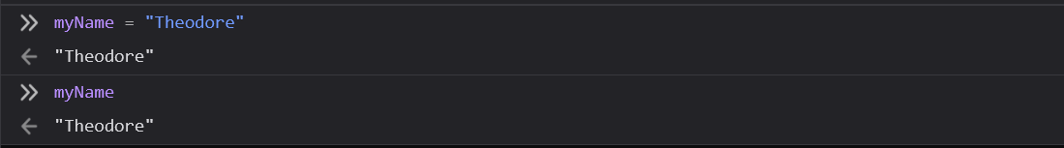
Assigning a Variable a Value
If you open your Web Console and try out the previous pseudo-code…
myName = “Theodore”
The name “Theodore” will be stored in your variable: myName
You can confirm this by outputting the myName variable: output(myName). The Web Console will output the name stored in that variable.
The “=” sign is the assignment operator. It is used exclusively to assign a value to a variable by name.
Notes:
Remember how we mentioned “syntax” for JavaScript? Note that we are not following proper syntax or convention in this example—we’re missing a couple of things!
Let’s go over how to write a proper declaration in JavaScript.

Slide 8
Declarations
When you are making a new variable and assigning it, there are special keywords we should be using. Each one works a little bit differently—let’s go over each now!
var Var is no longer regularly used, it is seen as bad practice with few exceptions. Variables declared using the var keyword are function-scoped, and can be reassigned. This is how all variables used to be declared.
let Variables declared with the let keyword are block-scoped (this means they are more conservative with memory usage), and can be reassigned. If you know your variable might need to be reassigned, this is the way to go!
const Variables declared with the const keyword are block-scoped, and cannot be reassigned. If the value of the variable will never be reassigned, use this. Attempting to re-assign a const variable will result in an error.
Notes:
We will go over functions and code-blocks in more detail later.
Note that a code-block is typically any “block of code” contained within a pair of curly braces.

Slide 9
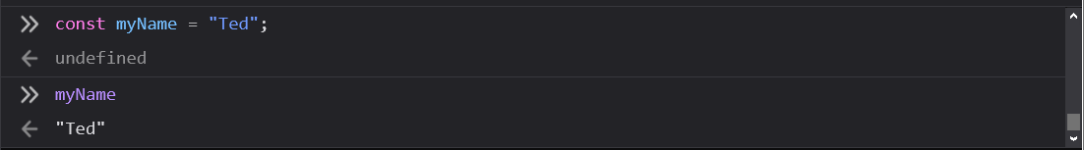
Let’s try that Assignment Again
Previously we typed…
myName = “Theodore”
This isn’t good code! Following proper JavaScript syntax and convention it is expected that we use a declaration keyword, and end our line with a semicolon.
When in doubt, try using const. If you run into an error later, you can always change your code to make use of let instead!
const myName = “Ted”;
We should always use declaration keywords. Let’s get in the habit of thinking which keyword to use!
Notes:
This new example is written much better!

Slide 10
Variable Scope
Variables declared inside a { } block cannot be accessed by code outside of the block! For example:
{
let myNum = 1;
let myNum2 = myNum;
//this is valid code as both variables are in the same block
}
let myNum3 = myNum; //this is invalid code, as myNum is in a block and cannot be accessed by myNum3, which is outside of the block
Scope determines the visibility of variables to other parts of the program.
Notes:
This new example is written much better!

Slide 11
Let’s have a closer look at some of the most common data-types.

Slide 12
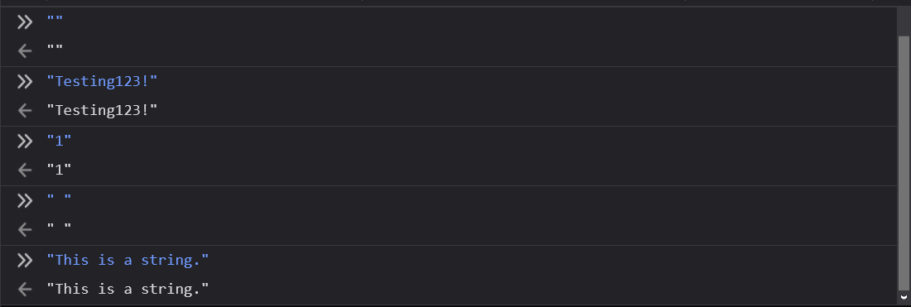
Strings
A string is a collection of zero or more characters.
Note that text characters can be letters, numbers, spaces, or even symbols like an exclamation mark!
Whenever you use a string in an expression or you assign one as a value, you must wrap the text in quotes. Single or double quotes will do.
Examples of strings...
Strings are just text; our previous examples were strings!

Slide 13
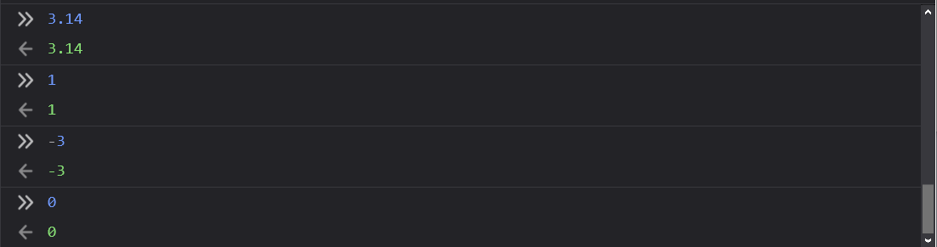
Numbers
Numbers are… well… numbers!
They’re especially useful when we need to perform math operations.
Note that, unlike strings, we don’t wrap numbers with quotations.
Some examples of numbers...
Numbers can be integers (whole numbers) or floating-point (decimal) numbers.
Notes:
Most language keep floating-point and integers completely separate as (at least) two different data-types—JavaScript is atypical in its handling most any number under the same data-type in contrast.
Be aware other languages often feature: Int32; Int64; Float; Double; and sometimes more.

Slide 14
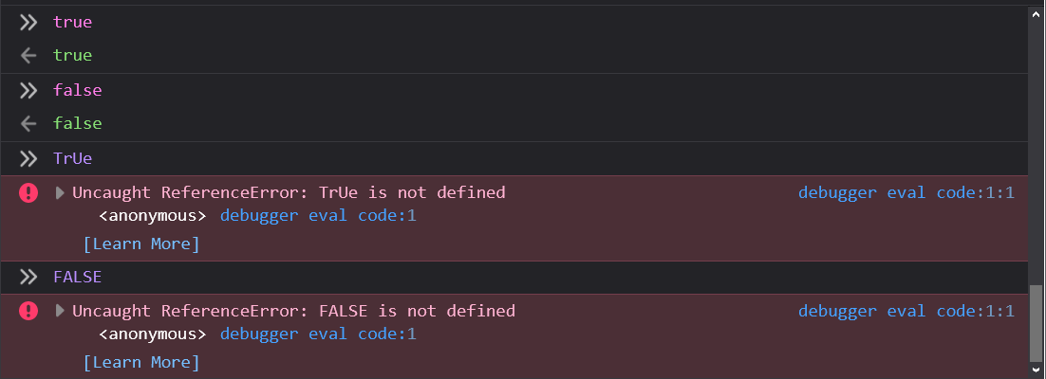
Booleans
A boolean can either be true or false, nothing else!
Note that boolean values are also written without quotation marks.
Boolean values are capital-sensitive, which means you must specifically express them as true and false. Something like True or FALSE would result in an error, as the value is invalid.
Booleans are a binary data-type—there are only two possible states!

Slide 15
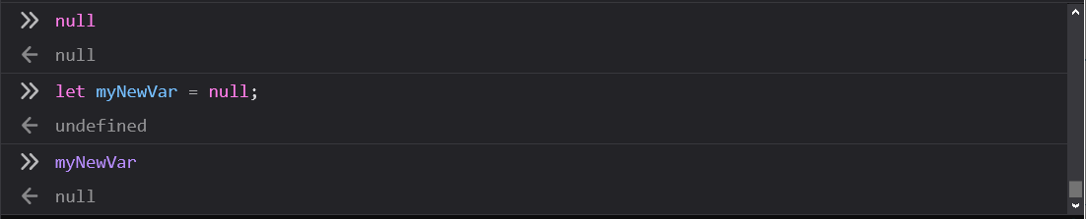
null
You can assign a variable the value of null to communicate that there is no intended value or alternative type you’d like to give it.
This is about as empty and void of meaning you can make a value outside of not defining it at all.
null is capital-sensitive.
When you encounter the need for an intentional absence of a value or any particular type, null is the available option.

Slide 16
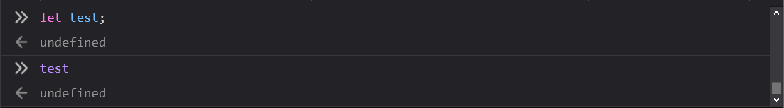
undefined
Try declaring a variable with something like…
const myTestVar;
or…
let test;
Notice there’s no assignment! If you call upon these named variables later in your program, you’ll be met simply with undefined to let you know.
undefined is capital-sensitive.
When a variable exists, but there are no values assigned to it yet, you’ll be met with the undefined value to let you know!

Slide 17
Are there ways of telling what data-type a variable or value is?

Slide 18
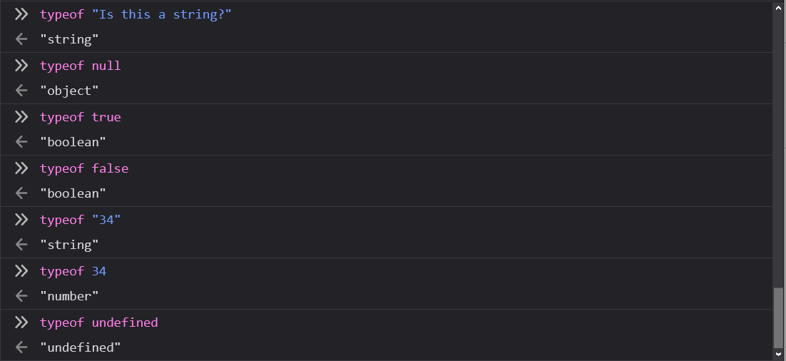
The typeof Operator
If you place typeof before a value, JavaScript will return to you a string describing the data-type.
Give it a try in your Web Console!
typeof is capital-sensitive.
Note: Do to legacy (backwards-compatibility) reasons, null identifies as an object.

Slide 19
Working With Primitives
JavaScript

Slide 20
Dealing with Strings.
Notes:
Let’s go over a few common methods we can use to play with strings.

Slide 21
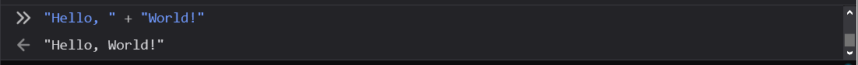
Concatenation
+ is the concatenation operator. When it is found between strings, it will glue the text together!
Especially once variables get involved, this is extremely common.
We can “glue” two pieces of text together into one string using concatenation.

Slide 22
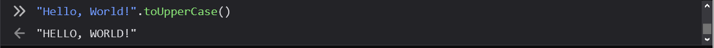
toUpperCase
To use a string method, follow a string value or variable with a period, the name of the method, and finally a pair of parentheses.
See the pattern in action below with the toUpperCase string method!
“Hello, World!”.toUpperCase()
This example will return to you the text: “HELLO, WORLD!”
Don’t forget that these methods will all be capital-sensitive—it’s the JavaScript way!
A method of strings, capable of turning text into a new uppercase copy of the string.

Slide 23
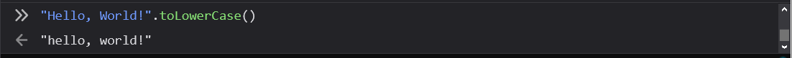
toLowerCase
As you can likely guess after trying out toUpperCase, the toLowerCase method does the opposite: a lower-cased version of the provided string will be returned to you.
“Hello, World!”.toLowerCase()
A method of strings, capable of turning text into a new lowercase copy of the string.

Slide 24
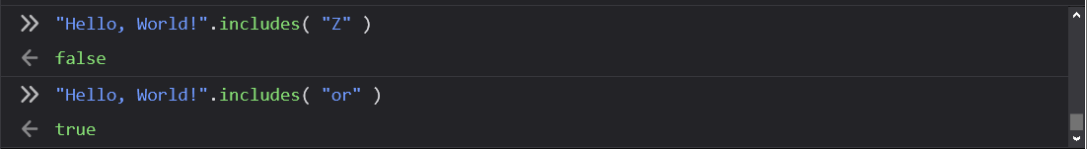
includes
You enter a string as an argument to the includes method, and it will determine if that text exists inside of the string you’re operating on.
The following will result in false, as “Z” is not inside of “Hello, World!”.
“Hello, World!”.includes( “Z” )
The following will result in true, as “or” does exist inside of “Hello, World!”.
“Hello, World!”.includes( “or” )
A method of strings, it checks if the string has a set of characters inside of it or not.

Slide 25
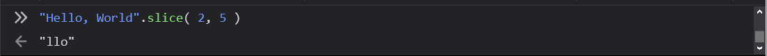
slice
slice takes two different arguments: the position of the beginning letter and the position of the last letter you’d like to cut out.
Count the letters in the string and you’ll see!
“Hello, World!”.slice( 2, 5 )
This cuts out and returns to you just “llo”, from the original string “Hello, World!”.
Note that letter position starts at zero, not one!
Try changing the numbers between the parentheses, what happens?
A method of strings, it provides a cut version of the string containing only some of the text.

Slide 26
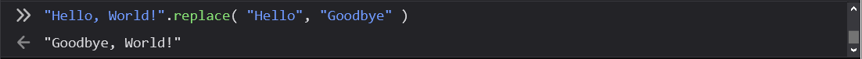
replace
replace takes two arguments: the text you’d like to target in the string, and the text you’d like to have take its place! It will return to you, a copy of the string with the replacement completed (if it found the target match, of course!)
Try this out…
“Hello, World!”.replace( “Hello”, “Goodbye” )
You’ll get “Goodbye, World!” after the replacement has done its magic.
A method of strings, it replaces target text with new text.

Slide 27
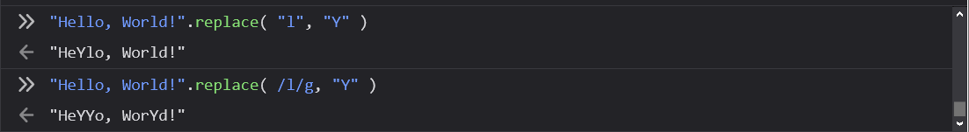
Regular Expressions with replace
Note that one of the limitations (see figure below) of replace when passing a string in as your target, is that it will only replace the first match.
You can target more than one match using advanced pattern-matching via Regular Expressions, or, RegEx.
Try the following:
“Hello, World!”.replace( /l/g, “Y” )
This will return to you the updated string “HeYYo WorYd!”
The power of pattern-matching within strings can be quickly multiplied with the use of regular expressions (“RegEx”.)
Notes:
If you want to learn more about regular expressions, there are tutorials on websites like https://regexone.com/

Slide 28
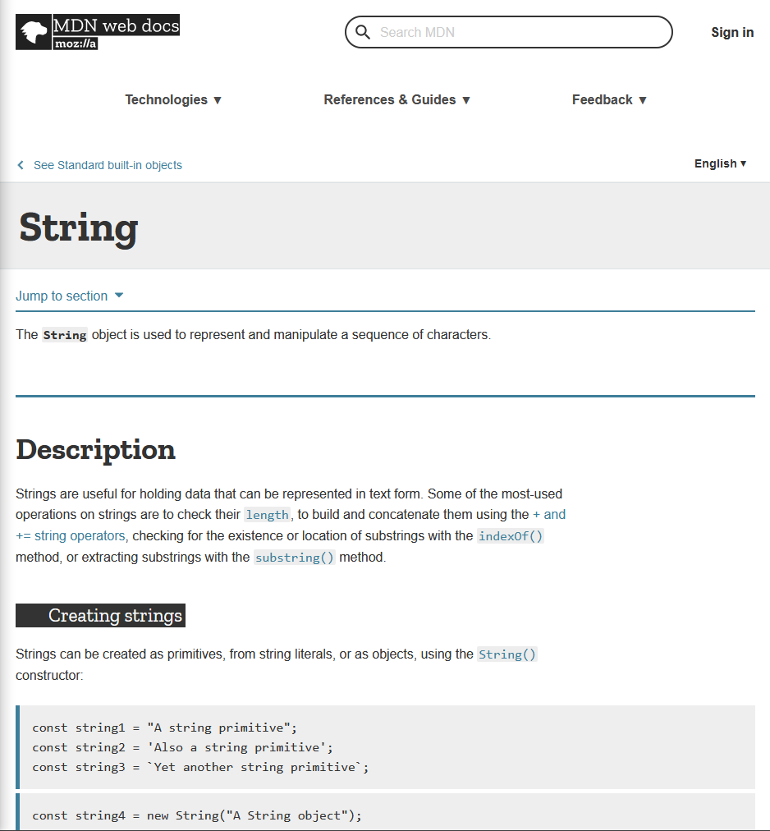
String Properties and Methods
There are plenty of more ways you can work with strings via their properties and methods.
Peruse the full list here.

Slide 29
Working with Numbers.

Slide 30
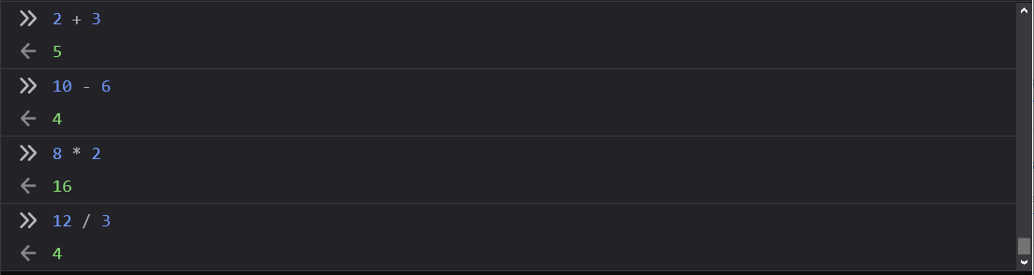
Mathematical Operators
+ the addition operator.
- the subtraction operator.
* the multiplication operator.
/ the division operator.
These work the way you’d expect! Give them a try in your Web Console.
We can do math with JavaScript! Much of it will look pretty familiar.
Notes:
You can also write exponents by simply using two asterisks.
5**2
=> 25

Slide 31
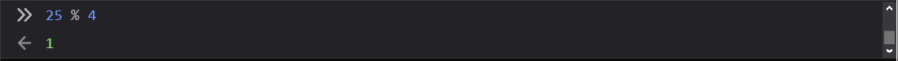
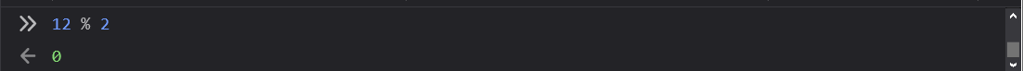
Modulus Operator
% is the modulus operator.
You can get the remainder of what would-be a division operation using this.
As an example, is commonly used for checking if a number is even or odd.
This symbol may feel a little less familiar—it is just a division remainder!

Slide 32
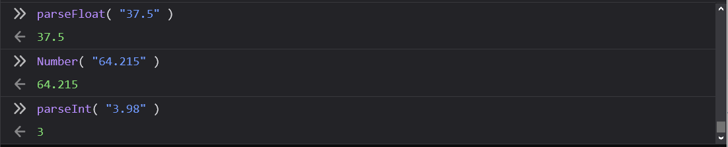
parseInt, parseFloat, and Number
The parseFloat and Number can be used to ensure a value is returned as a number (if possible.) If there are decimal values, they will be maintained.
parseInt works much the same, but will chop off any decimal points. Note that parseInt doesn’t round up or down.
You can pass strings with numeral characters, or full-on numbers into these functions.
We can transform strings composed of numeral characters into number data-type values.

Slide 33
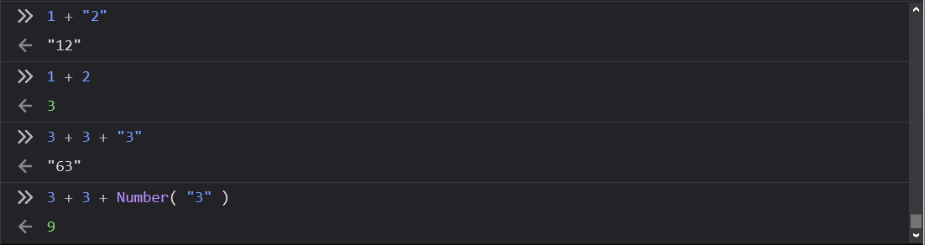
Addition Versus Concatenation
If a value on either side of a plus sign is a string, the operation will be concatenation.
If both values are of the number data-type, the operation will be addition.
Note you can leverage parseInt, parseFloat, and Number to convert strings if you need to ensure addition.
Try some of your own experiments!
You may have noticed that JavaScript uses the same symbol for both addition and concatenation, we do have to be careful.

Slide 34
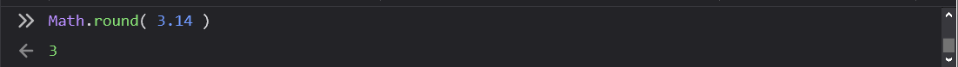
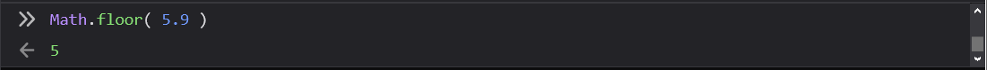
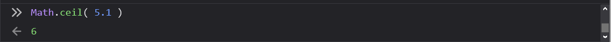
Math Round, Floor, and Ceiling
Math.round is used for traditional rounding of a number to the nearest integer (whole number.)
Math.floor will round down to the nearest integer.
Math.ceil will round up to the nearest integer.
JavaScript’s built-in Math class has some great methods.

Slide 35
Increment, decrement, and assignment operators
++ will increment a value up by 1.
let myNum = 1;
myNum++; //myNum is now 2
- - will decrement a value by 1.
let myNum = 1;
myNum--; // myNum is now 0
= will assign a value to a variable.
let myNum = 50;
let myNum2 = myNum; //myNum2 is now 50
The following methods can be used to increment a value, decrement a value, or assign a value to a variable.

Slide 36
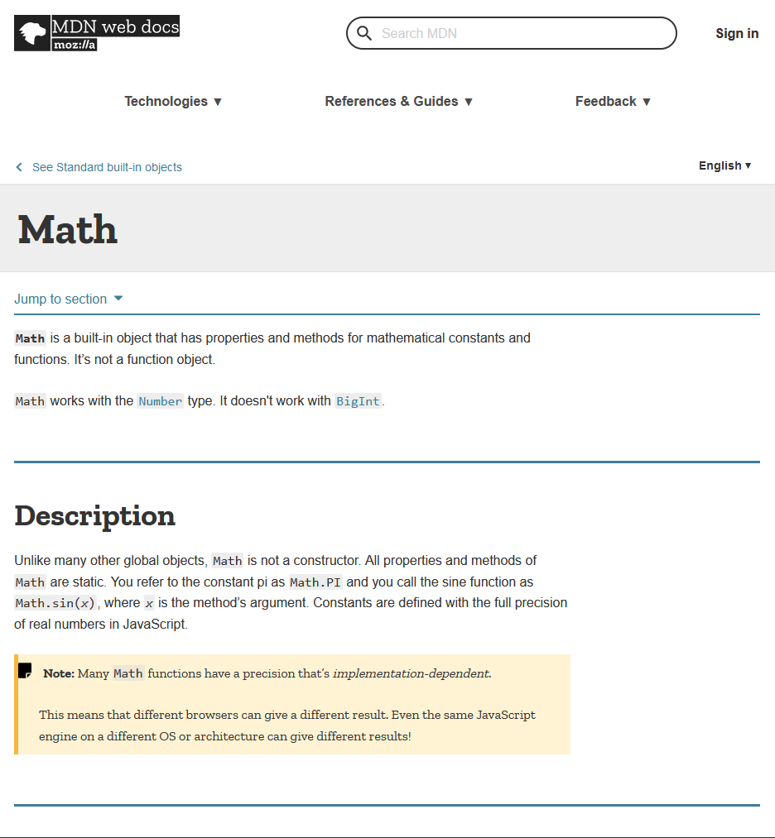
Math Object
JavaScript’s Math class has a lot more built-in properties and methods.
Check out the full list to see what it is capable of!

Slide 37
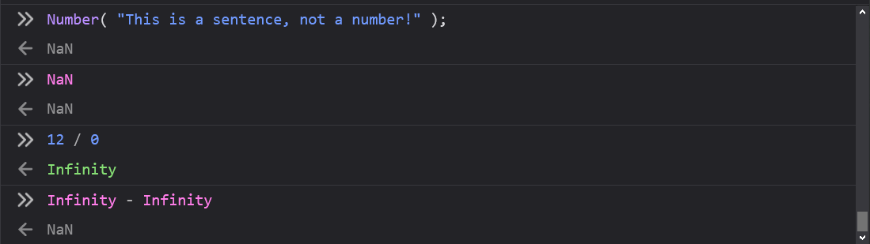
One More Thing! NaN and Infinity
NaN stands for “Not a Number.”
If a mathematical operation cannot be understood by JavaScript, or is impossible to express a result for within JavaScript’s ability, you’ll see this as the returned result.
JavaScript also has a representation for infinity (∞), intuitively named Infinity.
Remember: JavaScript is capital-sensitive!
Another couple of results that may catch you off guard when dealing with numbers are the NaN and Infinity values.

Slide 38
Escape Sequences
When we need to put quotation marks in a string, how do we ensure that JavaScript does not take the embedded quotation mark as an end to our string? For example:
let text = "We are the so-called "Vikings" from the north.";
As we can see, JavaScript would assume that the string begins with “We”, and takes the quotation mark before “Vikings” as the end of the string. How we get around this is with escape sequences! In JavaScript, an escape sequence is a backslash, followed by the symbol (in this case, the quotation mark!)
let text = "We are the so-called \"Vikings\" from the north.";
For when we want to put quotations within quotations.

Slide 39
JavaScript Worst Practices
Make types explicit when possible! This avoids implicit type conversion and unpredictable results.
Avoid using var! Let and const are better ways to declare variables!
Avoid using single character or gibberish variables. Remember that your code is likely to be read by others or yourself down the line. By making your variables descriptive, you will save both yourself and your colleagues some frustration.
Avoid inline code injection when possible. Don’t be tempted to inject HTML and CSS into your code for convenience. Do it right!
The following are bad practices to avoid!

